Slide 1
File Format Benchmark - Avro, JSON, ORC, & Parquet
Owen O’Malley
owen@hortonworks.com
@owen_omalley
September 2016

Slide 2
Who Am I?
Worked on Hadoop since Jan 2006
MapReduce, Security, Hive, and ORC
Worked on different file formats
Sequence File, RCFile, ORC File, T-File, and Avro requirements

Slide 3
Goal
Seeking to discover unknowns
How do the different formats perform?
What could they do better?
Best part of open source is looking inside!
Use real & diverse data sets
Over-reliance on similar datasets leads to weakness
Open & reviewed benchmarks

Slide 4
The File Formats

Slide 5
Avro
Cross-language file format for Hadoop
Schema evolution was primary goal
Schema segregated from data
Unlike Protobuf and Thrift
Row major format

Slide 6
JSON
Serialization format for HTTP & Javascript
Text-format with MANY parsers
Schema completely integrated with data
Row major format
Compression applied on top

Slide 7
ORC
Originally part of Hive to replace RCFile
Now top-level project
Schema segregated into footer
Column major format with stripes
Rich type model, stored top-down
Integrated compression, indexes, & stats

Slide 8
Parquet
Design based on Google’s Dremel paper
Schema segregated into footer
Column major format with stripes
Simpler type-model with logical types
All data pushed to leaves of the tree
Integrated compression and indexes

Slide 9
Data Sets

Slide 10
NYC Taxi Data
Every taxi cab ride in NYC from 2009
Publically available
http://tinyurl.com/nyc-taxi-analysis
18 columns with no null values
Doubles, integers, decimals, & strings
2 months of data – 22.7 million rows

Slide 11



Slide 12
Github Logs
All actions on Github public repositories
Publically available
https://www.githubarchive.org/
704 columns with a lot of structure & nulls
Pretty much the kitchen sink
1/2 month of data – 10.5 million rows

Slide 13
Finding the Github Schema
The data is all in JSON.
No schema for the data is published.
We wrote a JSON schema discoverer.
Scans the document and figures out the type
Available at https://github.com/hortonworks/hive-json
Schema is huge (12k)

Slide 14
Sales
Generated data
Real schema from a production Hive deployment
Random data based on the data statistics
55 columns with lots of nulls
A little structure
Timestamps, strings, longs, booleans, list, & struct
25 million rows

Slide 15
Storage costs

Slide 16
Compression
Data size matters!
Hadoop stores all your data, but requires hardware
Is one factor in read speed
ORC and Parquet use RLE & Dictionaries
All the formats have general compression
ZLIB (GZip) – tight compression, slower
Snappy – some compression, faster

Slide 17


Slide 18
Taxi Size Analysis
Don’t use JSON
Use either Snappy or Zlib compression
Avro’s small compression window hurts
Parquet Zlib is smaller than ORC
Group the column sizes by type

Slide 19
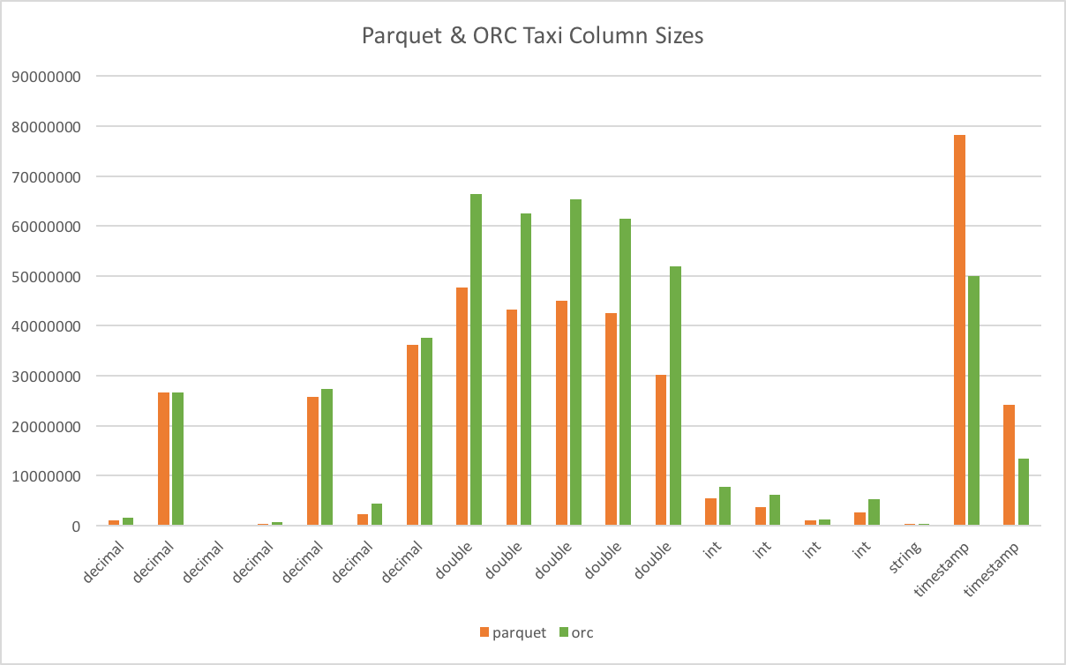

Slide 20
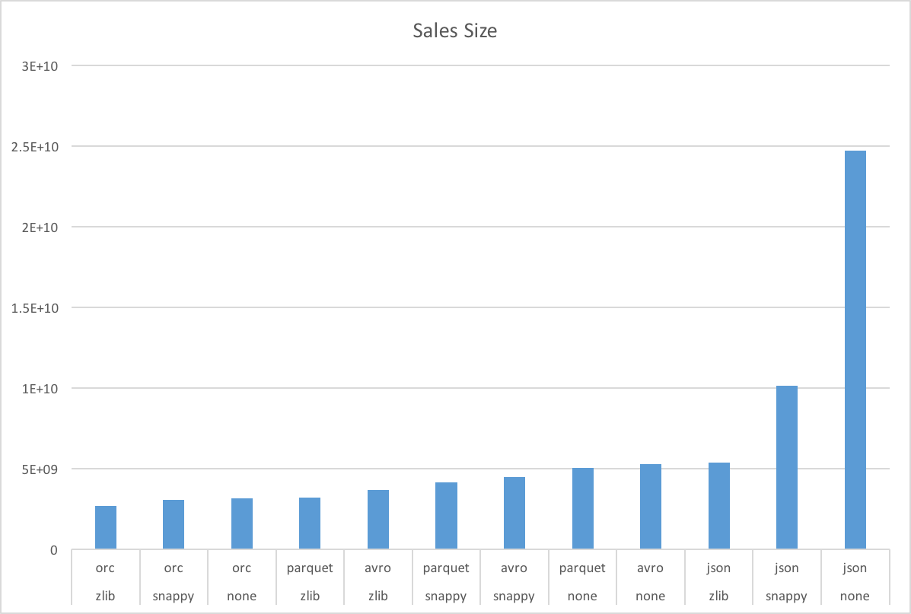

Slide 21
Taxi Size Analysis
ORC did better than expected
String columns have small cardinality
Lots of timestamp columns
No doubles ☺
Need to revalidate results with original
Improve random data generator
Add non-smooth distributions

Slide 22
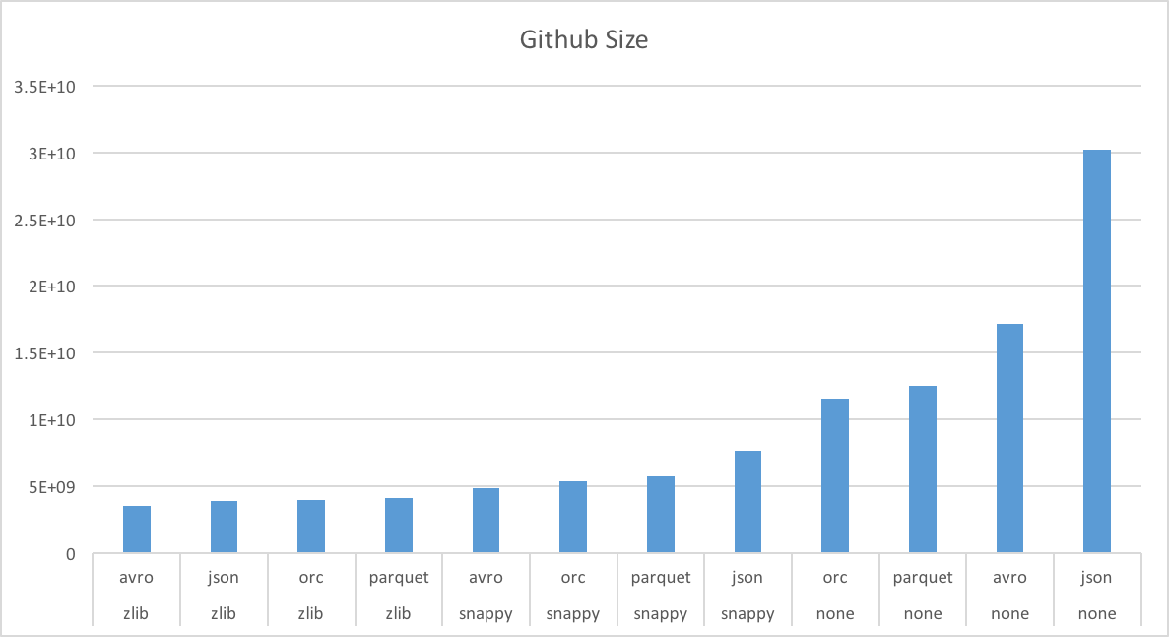

Slide 23
Github Size Analysis
Surprising win for JSON and Avro
Worst when uncompressed
Best with zlib
Many partially shared strings
ORC and Parquet don’t compress across columns
Need to investigate shared dictionaries.

Slide 24
Use Cases

Slide 25
Full Table Scans
Read all columns & rows
All formats except JSON are splitable
Different workers do different parts of file

Slide 26
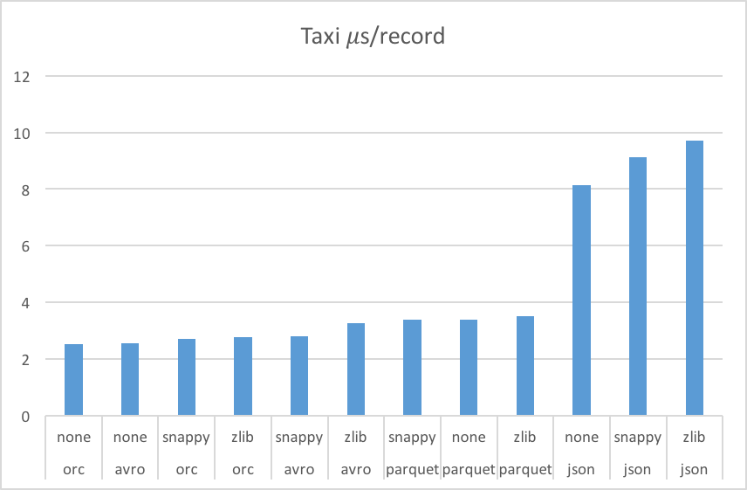

Slide 27
Taxi Read Performance Analysis
JSON is very slow to read
Large storage size for this data set
Needs to do a LOT of string parsing
Tradeoff between space & time
Less compression is sometimes faster

Slide 28
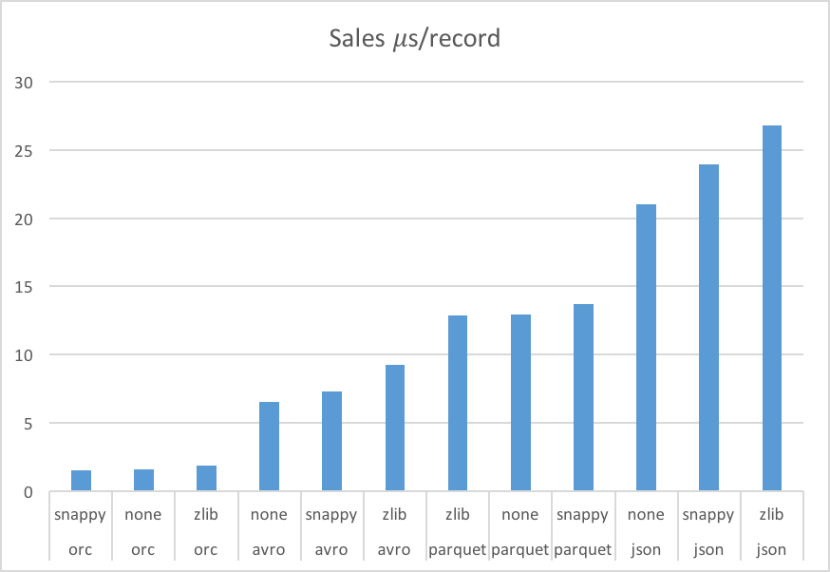

Slide 29
Sales Read Performance Analysis
Read performance is dominated by format
Compression matters less for this data set
Straight ordering: ORC, Avro, Parquet, & JSON
Garbage collection is important
ORC 0.3 to 1.4% of time
Avro < 0.1% of time
Parquet 4 to 8% of time

Slide 30
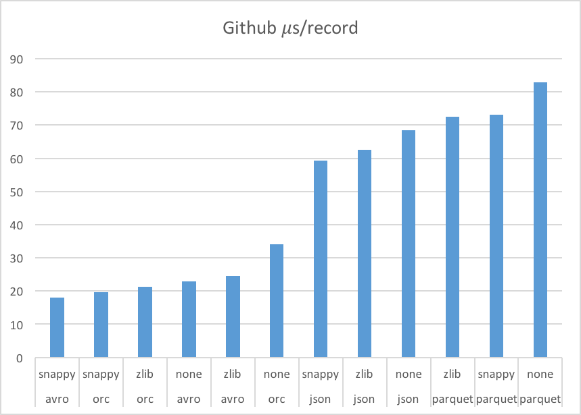

Slide 31
Github Read Performance Analysis
Garbage collection is critical
ORC 2.1 to 3.4% of time
Avro 0.1% of time
Parquet 11.4 to 12.8% of time
A lot of columns needs more space
Suspect that we need bigger stripes
Rows/stripe - ORC: 18.6k, Parquet: 88.1k

Slide 32
Column Projection
Often just need a few columns
Only ORC & Parquet are columnar
Only read, decompress, & deserialize some columns
Dataset | format | compression | us/row | projection | Percent time
github | orc | zlib | 21.319 | 0.185 | 0.87%
github | parquet | zlib | 72.494 | 0.585 | 0.81%
sales | orc | zlib | 1.866 | 0.056 | 3.00%
sales | parquet | zlib | 12.893 | 0.329 | 2.55%
taxi | orc | zlib | 2.766 | 0.063 | 2.28%
taxi | parquet | zlib | 3.496 | 0.718 | 20.54%

Slide 33
Projection & Predicate Pushdown
Sometimes have a filter predicate on table
Select a superset of rows that match
Selective filters have a huge impact
Improves data layout options
Better than partition pruning with sorting
ORC has added optional bloom filters

Slide 34
Metadata Access
ORC & Parquet store metadata
Stored in file footer
File schema
Number of records
Min, max, count of each column
Provides O(1) Access

Slide 35
Conclusions

Slide 36
Recommendations
Disclaimer – Everything changes!
Both these benchmarks and the formats will change.
Don’t use JSON for processing.
If your use case needs column projection or predicate push down:
ORC or Parquet

Slide 37
Recommendations
For complex tables with common strings
Avro with Snappy is a good fit (w/o projection)
For other tables
ORC with Zlib or Snappy is a good fit
Tweet benchmark suggestions to @owen_omalley

Slide 38
Fun Stuff
Built open benchmark suite for files
Built pieces of a tool to convert files
Avro, CSV, JSON, ORC, & Parquet
Built a random parameterized generator
Easy to model arbitrary tables
Can write to Avro, ORC, or Parquet

Slide 39
Remaining work
Extend benchmark with LZO and LZ4.
Finish predicate pushdown benchmark.
Add C++ reader for ORC, Parquet, & Avro.
Add Presto ORC reader.

Slide 40
Thank you! Twitter: @owen_omalley Email: owen@hortonworks.com

